Slide 1

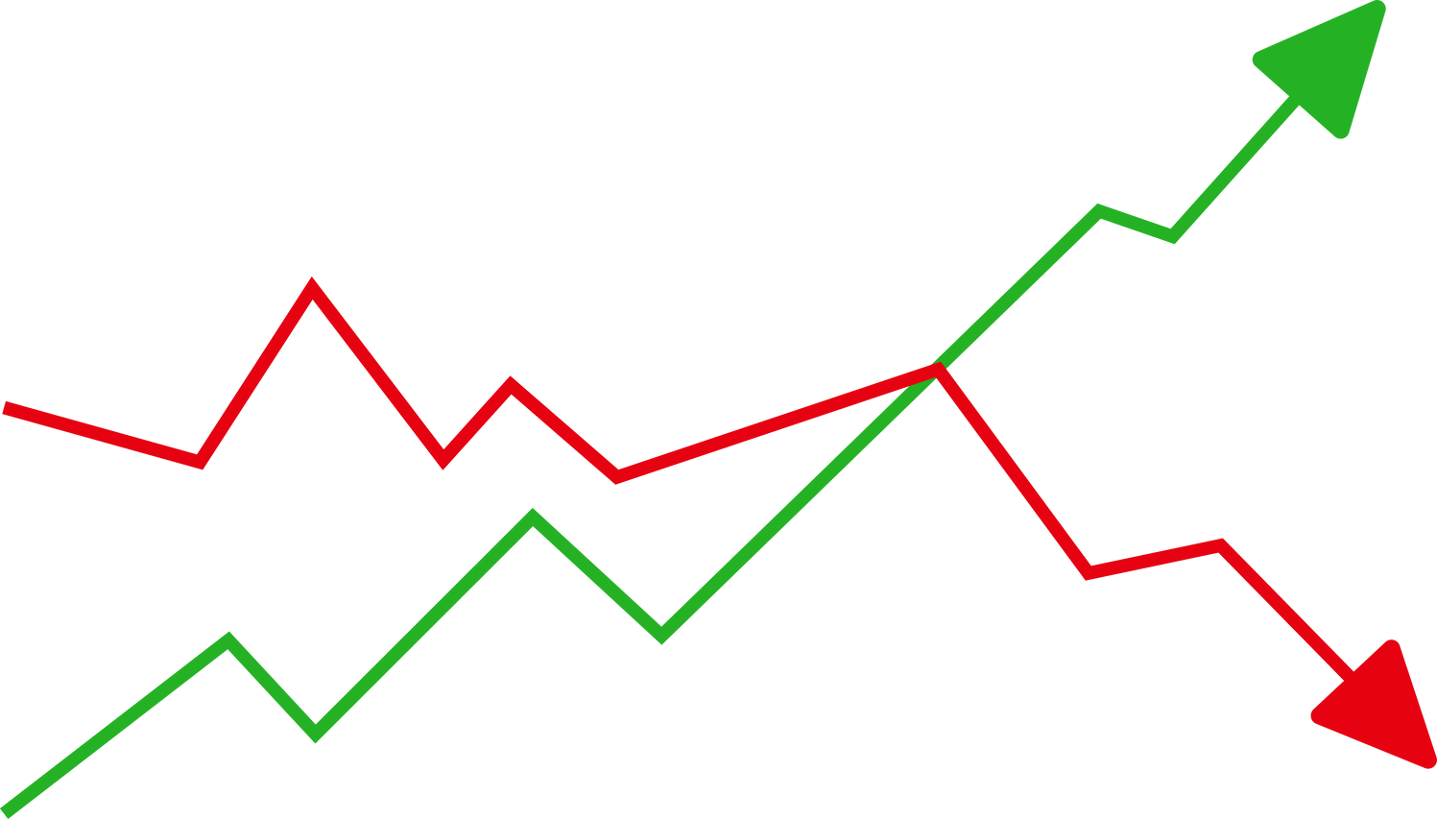

MGT1063 - Financial management
TradeCraft:
Building Profitable Strategies with Zipline and PyFolio
Sri Karthik A | Nithin Kodipyaka | Akila B
Simran Bohra | Vinayaka Srinivas | Shreyas V

Slide 2

Outline
Risk assessment and measurement, formerly a rather arcane topic, are now essential tasks for traders and portfolio managers. However, there are numerous real-world obstacles to precise risk assessment and analysis, such as selecting the right risk model, avoidance of mistakes in portfolio optimisation, horizon mismatches, and out-of-sample testing. This study offers a thorough review of current advancements in risk modelling and analysis with an emphasis on useful applications for traders and portfolio managers. We show that while these methods can offer priceless insights into portfolio risk, their application requires great caution. Nowadays, risk analysis is both a science and an art.

Slide 3
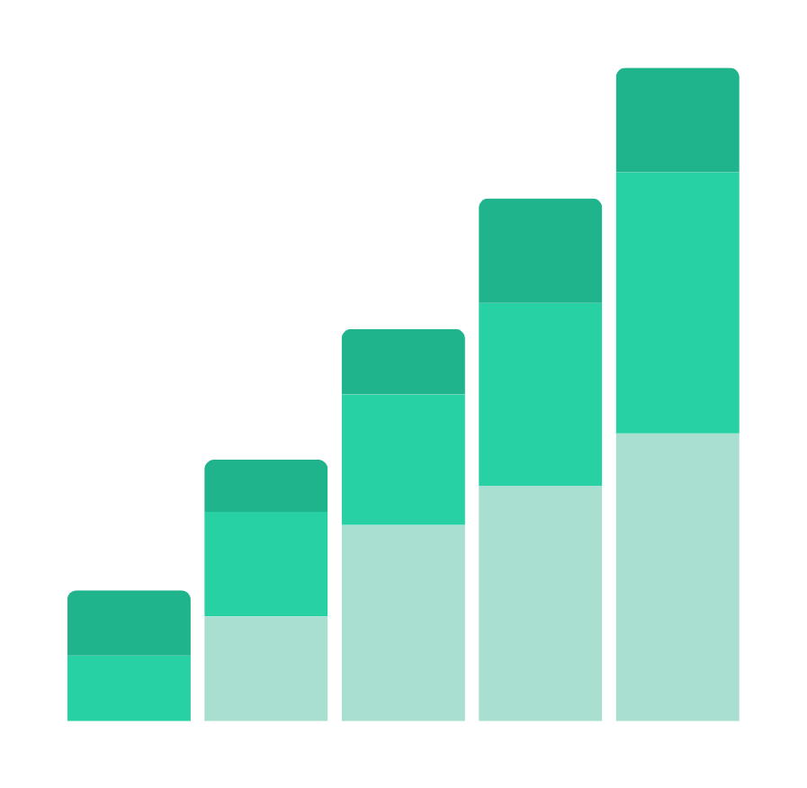

Introduction
In today's dynamic financial landscape, risk analysis and measurement have evolved from niche concepts to essential components of effective portfolio management and trading strategies. However, mastering the accurate assessment and analysis of risk poses numerous practical challenges, ranging from selecting appropriate risk models to avoiding pitfalls in portfolio optimization. Moreover, issues such as horizon mismatches and the importance of out-of-sample testing further complicate the process.

Slide 4


Problem Statement
This project aims to provide a comprehensive overview of recent advancements in risk analysis and modelling, emphasizing their practical applications for both portfolio managers and traders. By delving into these developments, we seek to demonstrate how these tools can offer invaluable insights into portfolio risk dynamics. Nonetheless, it's crucial to recognize that while risk analysis has advanced significantly, it remains as much an art as it is a science, demanding careful application and interpretation.

Slide 5
Portfolio
01.
02.
03.
Analysis
Performance and Forecast
Risk Evaluation

Slide 6


20
Literature Reviews

Slide 7
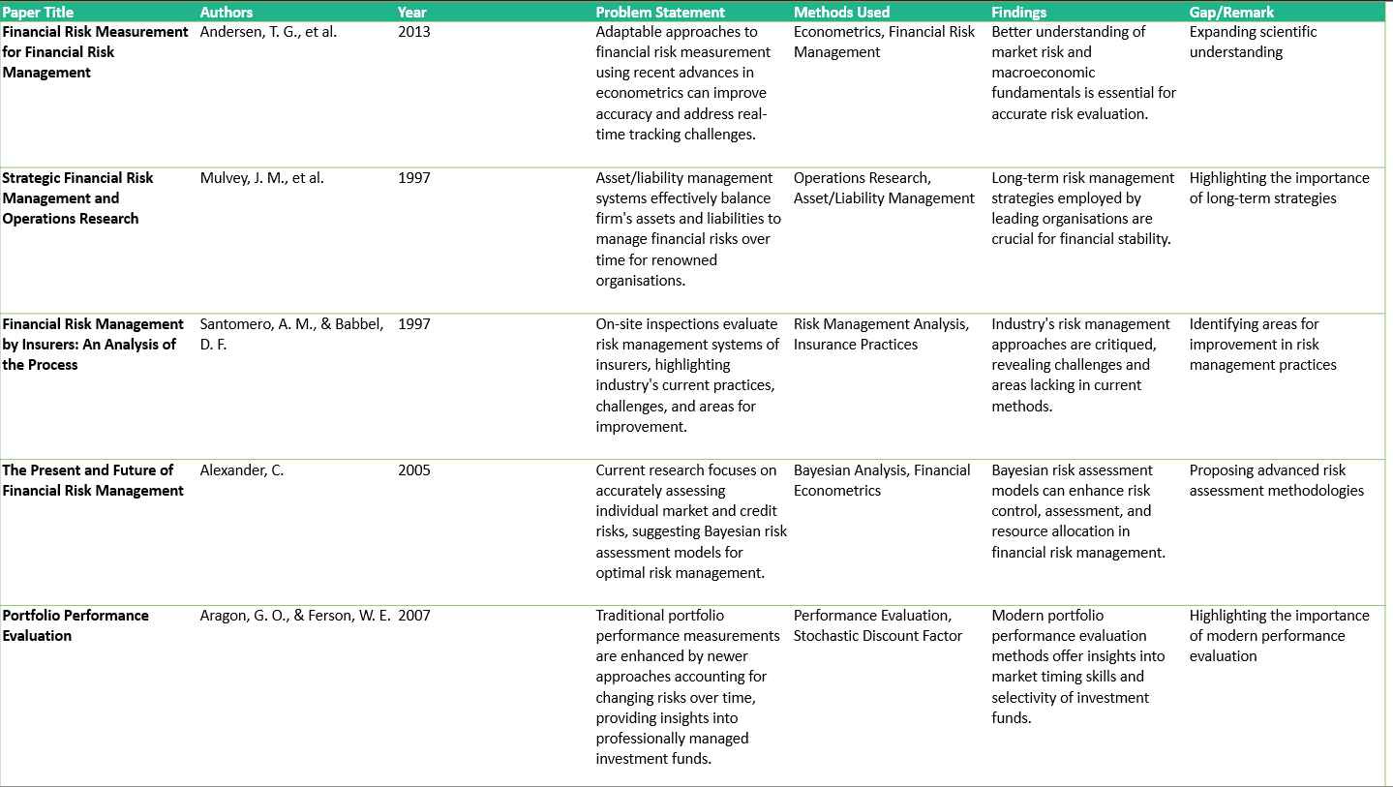

Slide 8
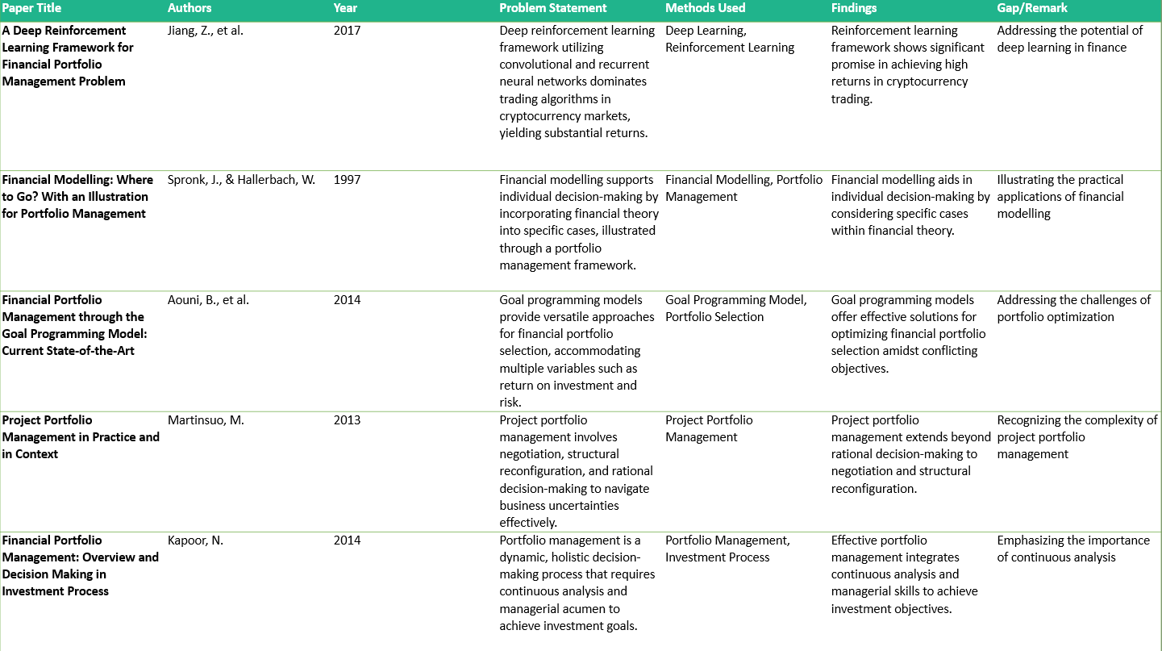

Slide 9
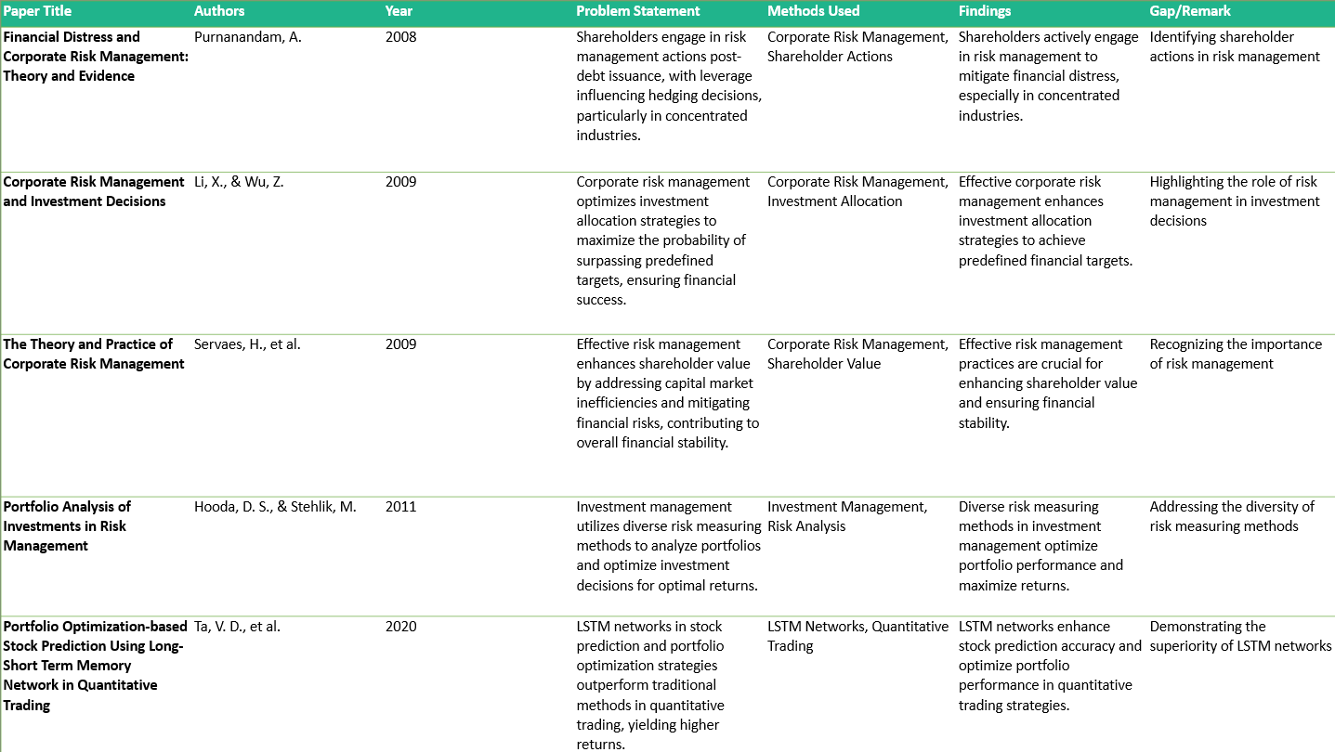

Slide 10
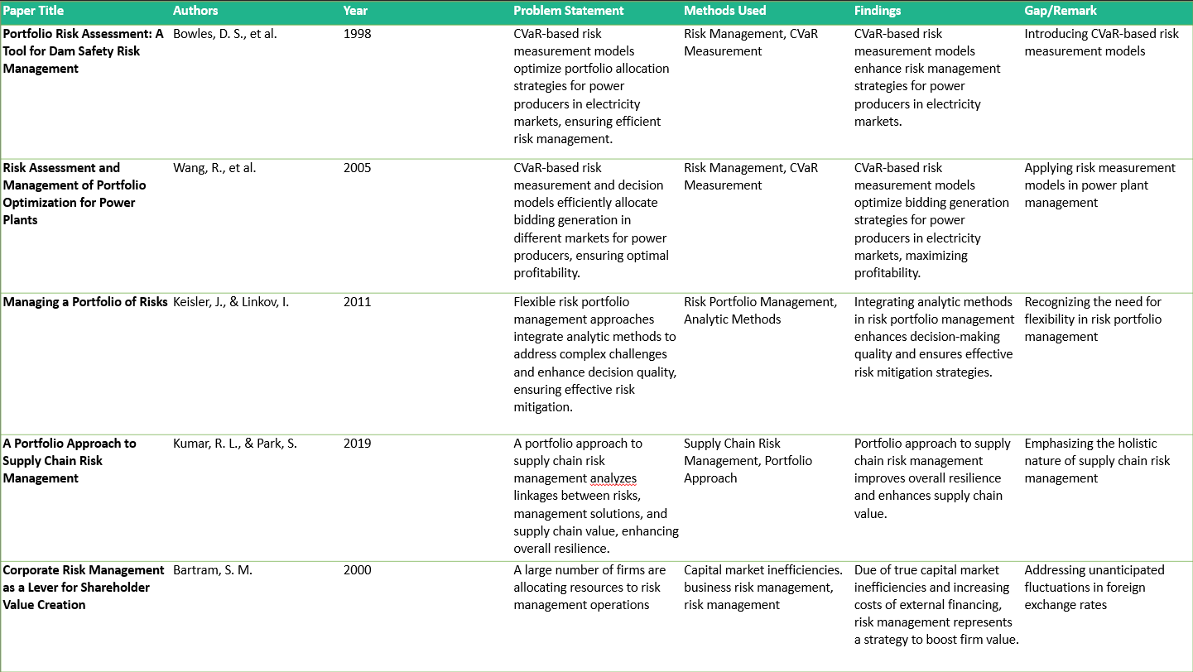

Slide 11
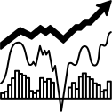
Data
Yahoo Finance S&P 500 Index

Slide 12

Workflow
Data Acquisition: Obtain historical market data.
Create Zipline Bundle: Prepare data for Zipline.
Factor Engineering: Define features like momentum, volatility.
ML Custom Factor: Implement ML model for predictions.
Pipeline Construction: Build pipeline for data processing.
Initialize Algorithm: Set parameters and schedule tasks.
Evaluate Predictions: Assess model performance.
Rebalance: Adjust portfolio based on predictions.
Logging: Record metrics for monitoring.
Run Algorithm: Execute trading algorithm.
Analysis with PyFolio: Evaluate performance using PyFolio.

Slide 13
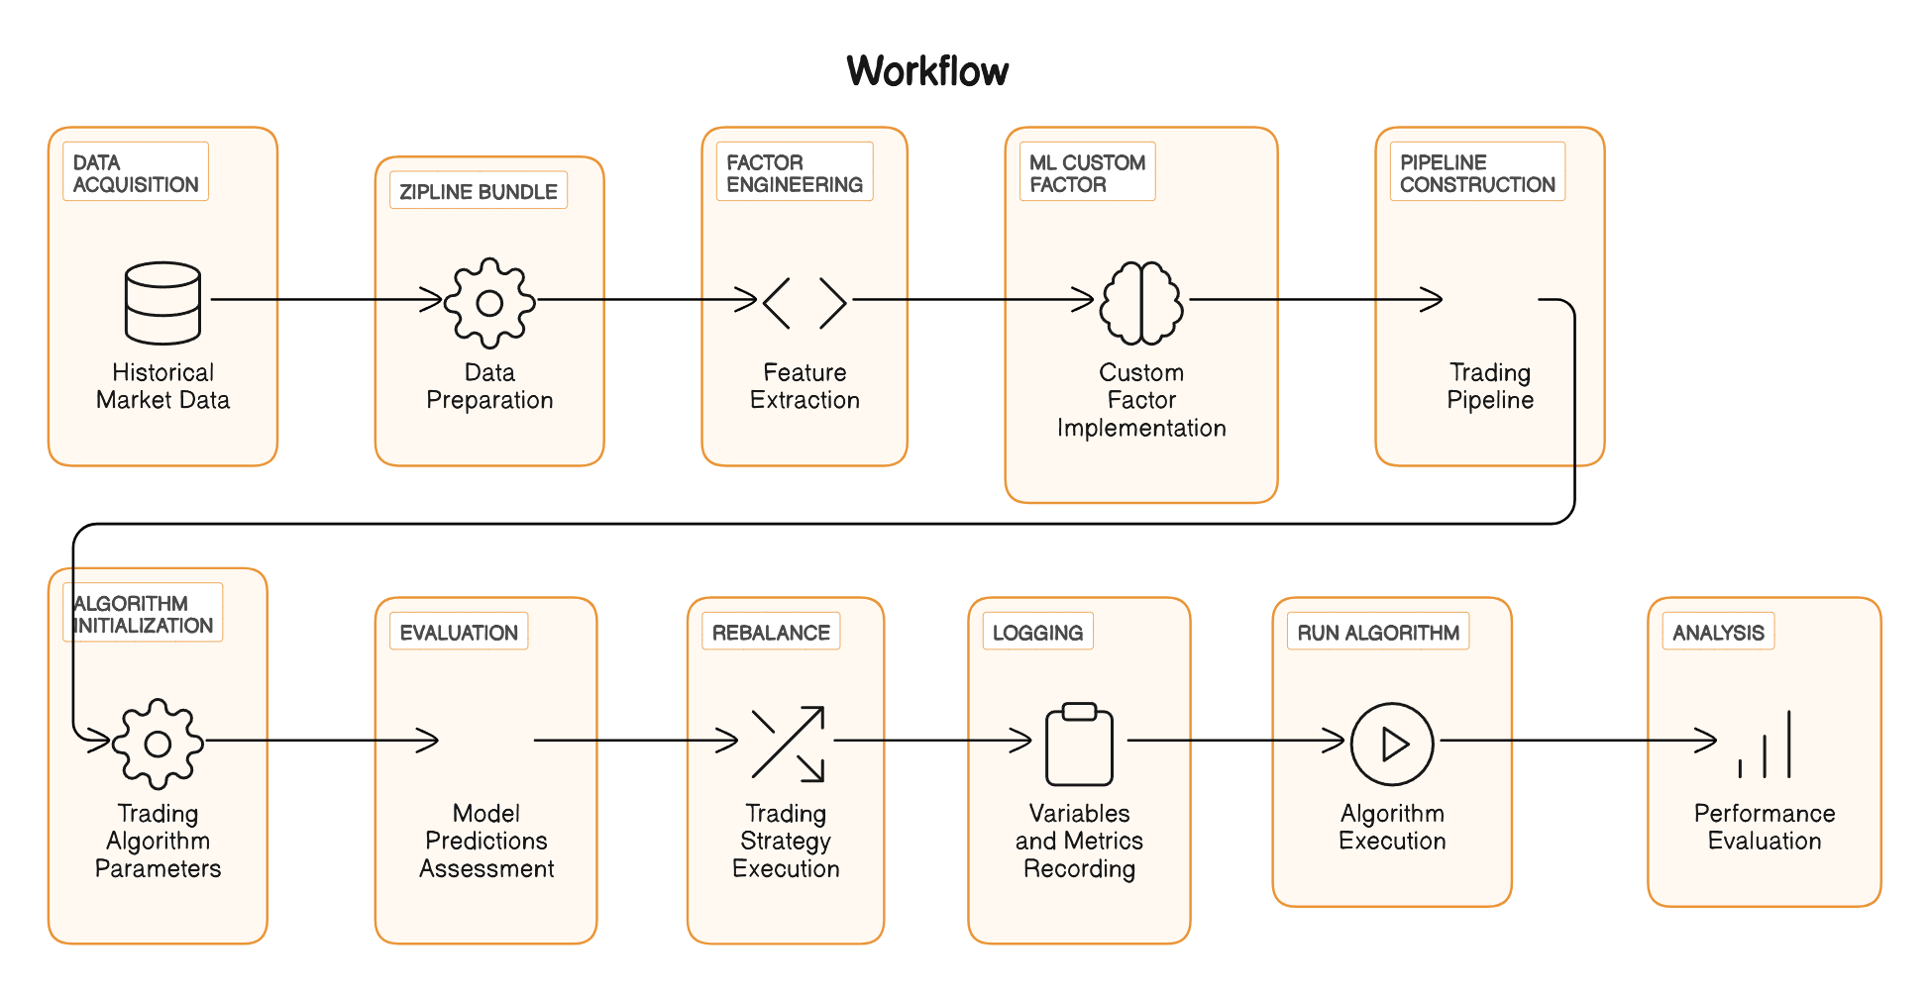
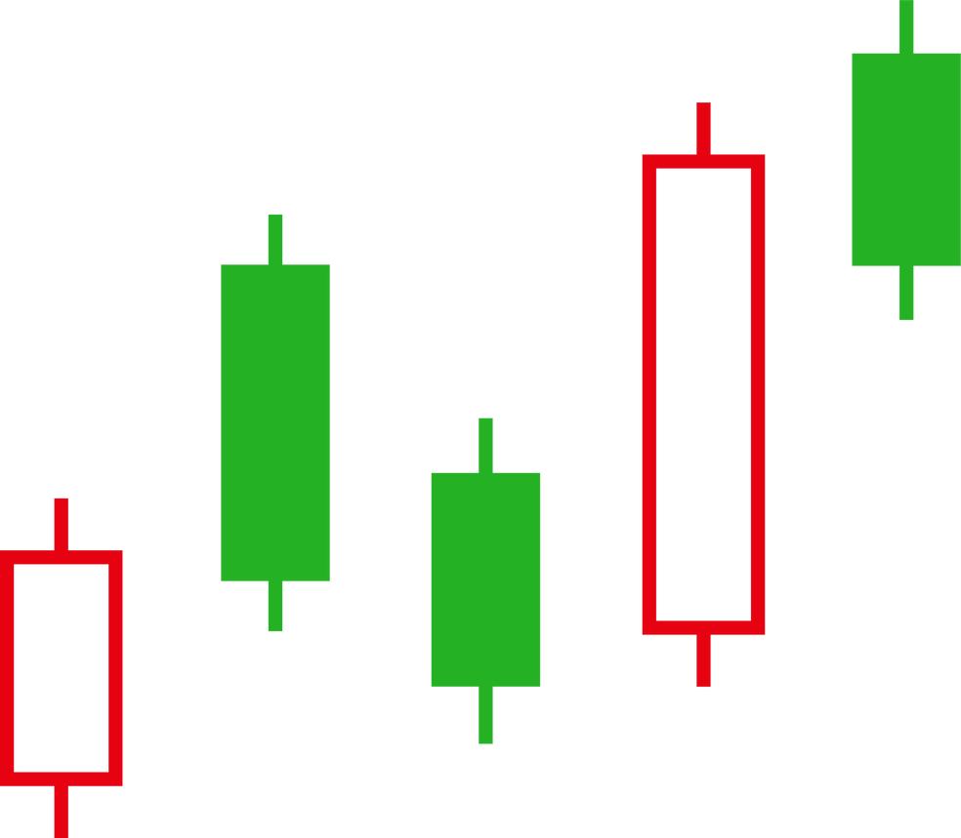


Slide 14

Zipline
Backtesting Framework: Zipline provides a comprehensive framework for backtesting trading algorithms using historical market data.
Data Ingestion and Management: Zipline allows users to ingest and manage historical market data through bundles, which are collections of data for specific assets.
Pipeline API: Zipline's Pipeline API enables the creation of complex trading strategies by defining factors, filters, and screens to select and manipulate data.
Integration with Machine Learning: Zipline seamlessly integrates machine learning models into trading algorithms through custom factors, allowing for predictive analytics and data-driven decision-making.
Execution Simulation: Zipline simulates the execution of trades based on specified parameters such as slippage, commission, and capital base, providing insights into the performance of trading strategies.

Slide 15

PyFolio
Performance Analysis: PyFolio is a powerful toolkit for analyzing and evaluating the performance of trading algorithms.
Return Analysis: PyFolio enables the calculation and visualization of various performance metrics, including cumulative returns, rolling returns, and Sharpe ratio.
Risk Assessment: PyFolio assesses the risk associated with trading strategies by analyzing factors such as volatility, drawdowns, and portfolio concentration.
Benchmarking: PyFolio compares the performance of trading algorithms against benchmark indices or portfolios, providing insights into relative performance and risk-adjusted returns.
Tear Sheet Analysis: PyFolio generates detailed tear sheets containing a comprehensive overview of algorithm performance, including returns, positions, transactions, and benchmark comparison.

Slide 16
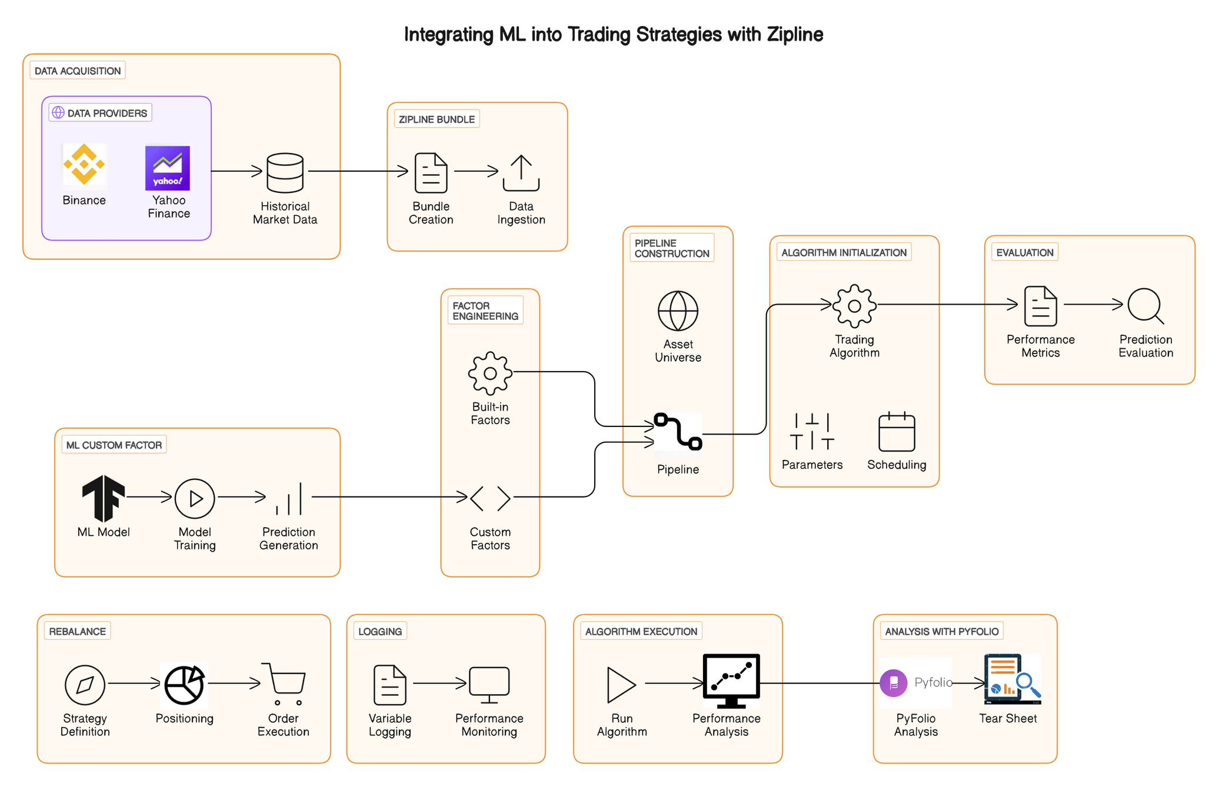

Slide 17
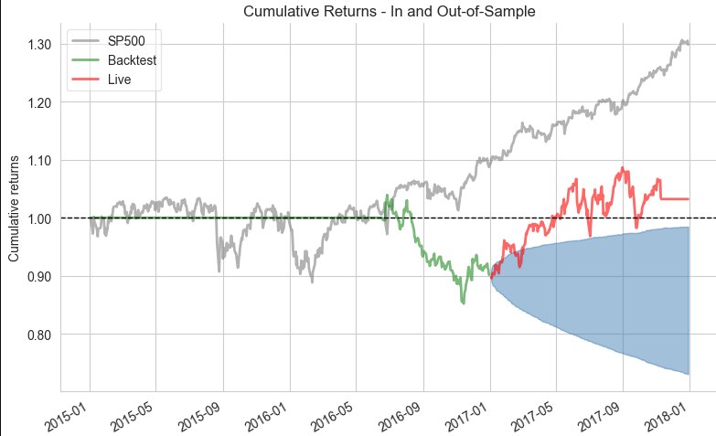
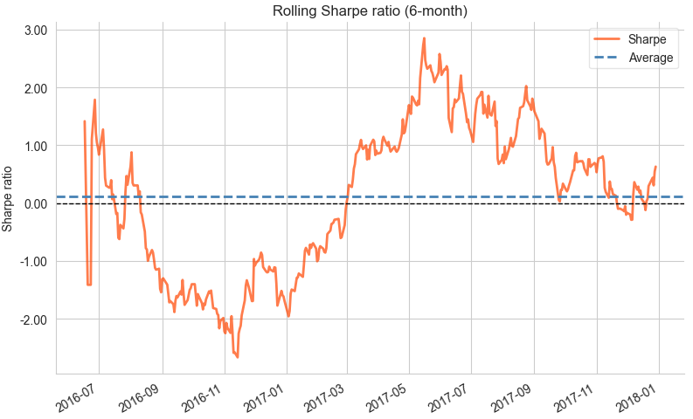
Results on Stock Data using PyFolio

Slide 18
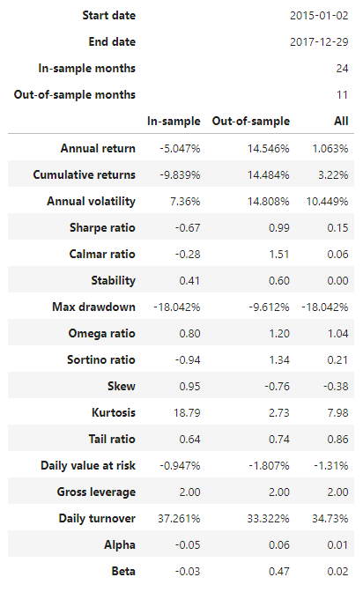
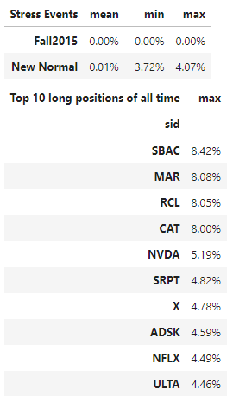
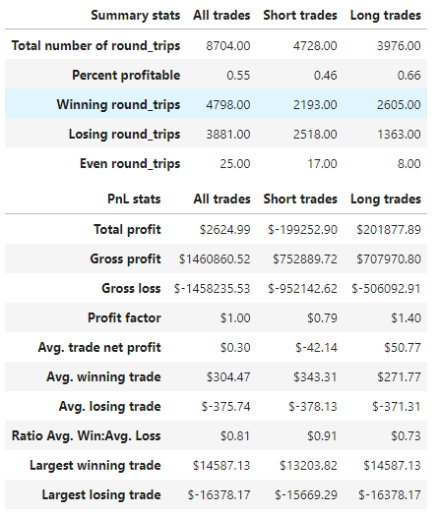
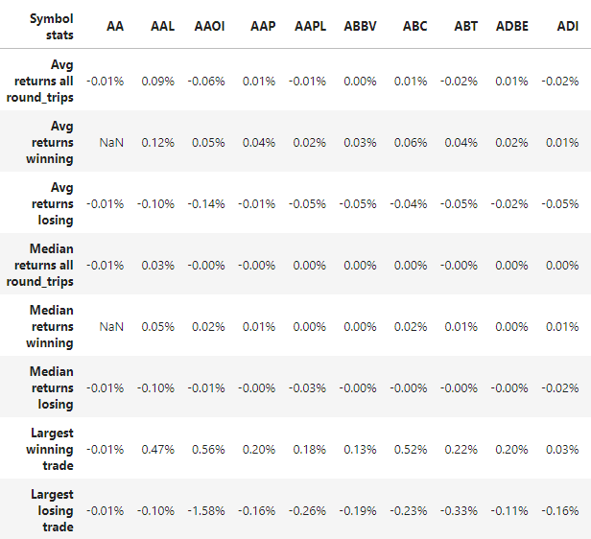
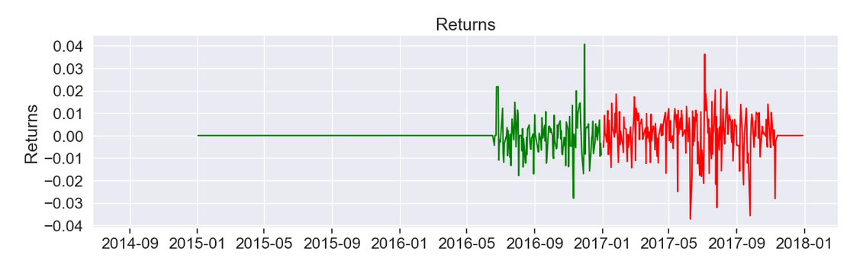
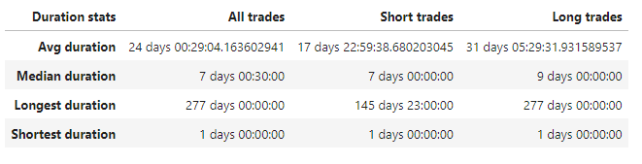
Tearsheet

Slide 19
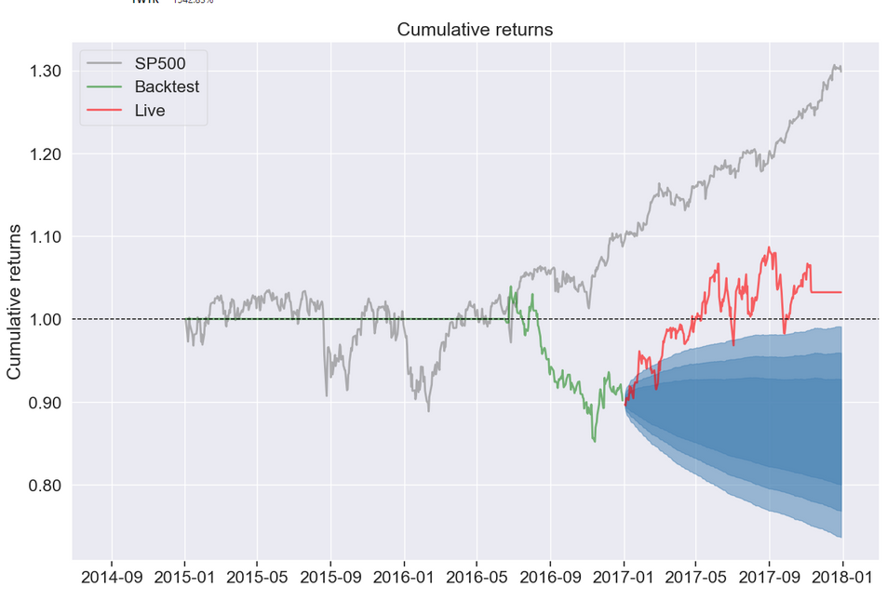
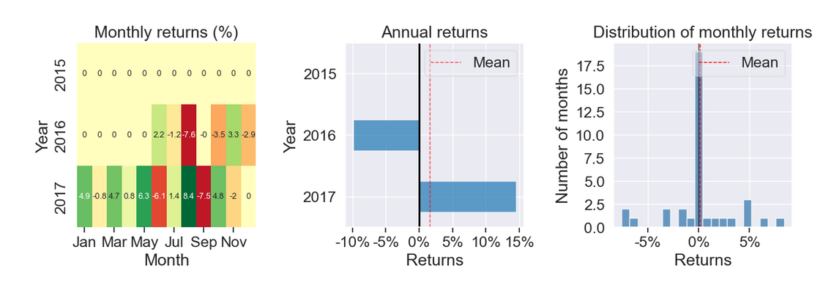
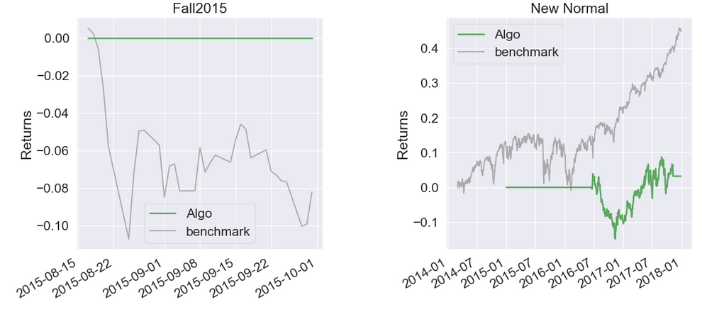
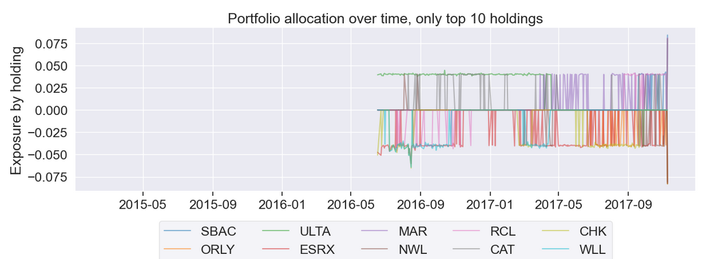
Tearsheet

Slide 20

Thank you
Team Members
Simran Bohra 20MIA1024
Sri Karthik A 20MIA1032
Vinayaka Srinivasa R 20MIA1041
Akila B 20MIA1052
Shreyas V 20MIA1063
Nithin Kodipyaka 20MIA1075

